Slide 1
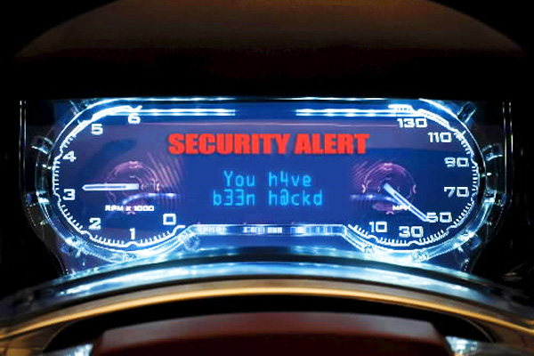
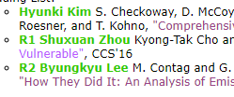

Comprehensive Experimental Analyses of Automotive Attack Surfaces
Security 101: Think Like an Adversary
2018.9.27
Hyunki kim
Authers: Stephen Checkoway, Damon McCoy, Brian Kantor,
Danny Anderson, Hovav Shacham, Stefan Savage, (UCSD)
Karl Koscher, Alexei Czeskis, Franziska Roesner, and Tadayoshi Kohno (UW)
Written by Sanha Park
Notes:
Hello, I am hyunki kim
Today, I will talk about a paper with a title “Comprehensive Experimental Analyses of Automotive Attack Surfaces.”
Did you read this paper?
I know that most of people didn’t read this paper , because this paper does not have R mark on class web site.
( click ) Like this

Slide 2
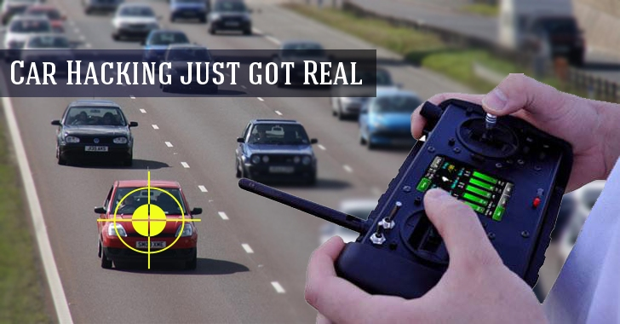
Intro
Notes:
Anyway, in recent years, Car hacking becomes reality.
Do you know that 찰리밀러 앤 크리스 발라섹 hacked jeep cherokee?
They showed that they could hack Jeep Cherokee remotely by hacking on 2015 Blackhat.
Let’s watch the demonstration.

Slide 3
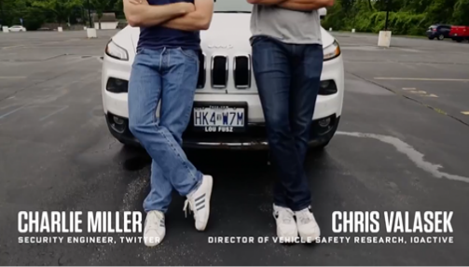
Intro
Jeep Cherokee hacked in 2015
Notes:
They are 찰리밀러 앤 크리스발라섹
This movie show that they could hack a car on remote.
When the target is on a highway, their hacking begins.
By hacking, they
Turn on the fan
upload the image on dashboard
Play the music
Turn on the wiper
terminate the engine
They can do anything.
Vidioe:https://www.youtube.com/watch?v=MK0SrxBC1xs&t=170s

Slide 4
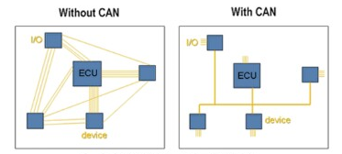
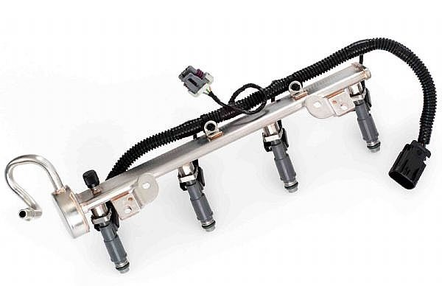
Why can we attack?
1980’s
Today
Notes:
Then, Why can we hack cars?
Up-to 1980s the cars were mechanical.
However, today, cars are like computers, comprised of critical components which are now electrical with CAN bus.
Here is an example of a carburetor, which mixes the gas with air before going into the engine.
A complex system of vacuum hoses, levers and valves controlled the fuel-to-air mixture so that the engine would operate properly.
Too much fuel, and the engine cylinders will saturate and the engine will be “flooded”, no ignition. Too little fuel, and the engine will run hot, ultimately causing a melt-down.
These systems require mechanical tuning!
Today, the engines use fuel-injectors, where a computer takes sensor measurements, calculates the proper fuel-to-air mixture and then pushes the fuel at the engine cylinder head.
So if you send malicious sensor data or other data to the machine, special errors may occur during processing of the data.
The following video will explain in detail

Slide 5
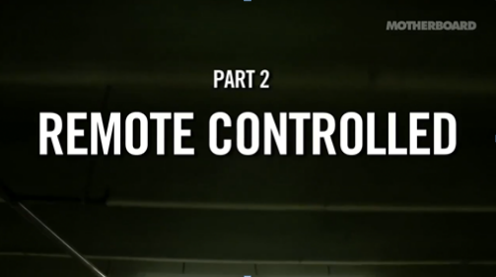
Why can we attack?
Notes:
They talk about overall architectures in detail.
Youtube : https://www.youtube.com/watch?v=3jstaBeXgAs&feature=youtu.be&t=54s

Slide 6
Cars’ system
Engine
Controller
Brake
Controller
Body
Controller
Airbag
Module
Instrument
Cluster
HVAC
Transmission
Controller
Telematics
Radio
Keyless
Entry
Receiver
Anti-Theft
Module
OBD-II
ECU(Electronic Control Unit) :
  Ubiquitous computer controller
ECU interconnection driven by
safety, efficiency, and capability requirements
But, also has some fatal shortcomings
Notes:
A car is designed like this picture.
Each controllers called ECU(Electronic Control unit) are connected via CAN bus.
This system has made cars smarter and more efficient, but it has also created the potential for a variety of new attacks, because messages are neither encrypted nor authenticated.
So, if we send malicious message to ecu via can bus, we can control the vehicle as we want.

Slide 7
Oakland 2010, they showed…
Safety-critical systems can be compromised
  Selectively enable/disable brakes
  Stop engine
  Control lights
Owning one ECU = total compromise
ECUs can be reprogrammed (while driving!)
Limit: Need physical access
[Oakland’10] koscher et al. Experimental Security Analysis of a Modern Automobile.
Notes:
In Oakland 2010, these authors already have shown that an attacker connected to the internal network could control critical systems, such as brakes module or engine module.
However, many people have criticized that such an attack is actually impractical and ineffective. First, the task of sending a specific packet to the CAN bus to control the engine or brake itself requires a great deal of expertise and Second, physical access is required to send the packet to the CAN bus, and also If physical access is possible, other attacks such as cutting the brake line will be much easier and more effective.
Then, what’s the difference between this 2010 paper and today’s paper?
Today’s paper shows that one can control cars remotely, considering all attack vectors allowing these remote attacks.
Now, let’s look at the threat model first.

Slide 8
Threat model
Technical (theoretical) Capabilities
  Capabilities in analyzing the system
  Focuses on making technical capabilities realistic
Operational (real-time) capabilities
  Show how malicious payload is delivered
  Attack vector
    Indirect physical access
    short-range wireless access
    long-range wireless access
Notes:
In this paper, they divide the threat model into two major categories: techinal capabilites and operational capabilites.
Technical Capabilities analyze the vulnerabilities of the overall system and focuses on making technical capabilities realistic.
Operational capabilities are a model for real attacks. The important thing is the attack vectors.
they are categorized as indirect, short-range, long-range
Now consider what parts can be used to access cars one-by-one.

Slide 9
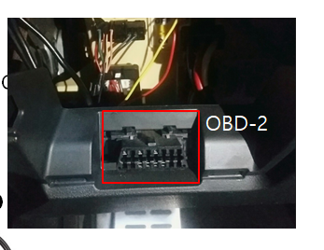
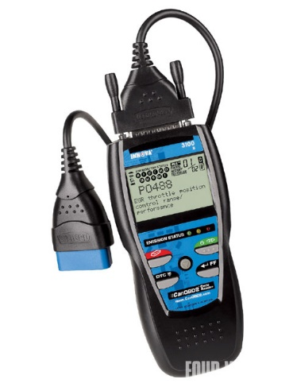

Indirect physical
Definition:
  Attacks over physical interfaces
  Constrained: Adversary may not directly access the physical interfaces herself
OBD(stands for On Board Diagnostic)
Port
Scanner
PassThru
Notes:
First is about indirect Physical Access.
they consider the physical access via 2 vectors.
OBD-2 port can connect to all important CAN buses.
Window-based Software on the laptop computer can then interrogate or program the car’s ECUs via device. (the software examples are Toyota’s TIS, Ford’s VCM)
So they note that the OBD-II port is commonly accessed by service personnel during routine maintenance for both diagnostics and ECU programming.

Slide 10
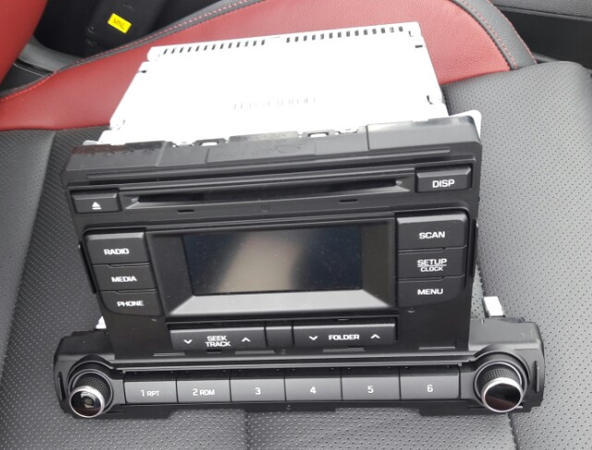
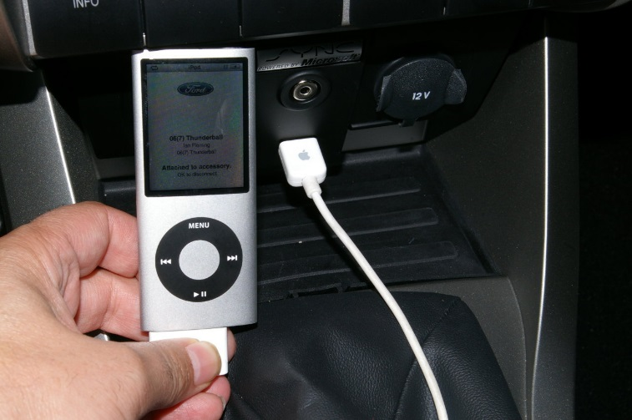
Indirect physical
Definition:
  Attacks over physical interfaces
  Constrained: Adversary may not directly access the physical interfaces herself
Extends attack surface to the device
Notes:
In addition, there are USB devices for connecting mobile phones and cars, disk for playing CDs, and so on.
Virtually all automobiles shipped today provide a CD player able to interpret a wide variety of audio formats (MP3, Window Media Audio file, and so on).
So. an adversary might deliver malicious input by encoding it onto a CD or as a song ﬁle and using social engineering to convince the user to play it.
Also, He might compromise the user’s phone or iPod and install software onto it that attacks the car’s media system when connected.
Many such systems are now CAN bus interconnected , these scenarios can offer an effective attack vector.

Slide 11

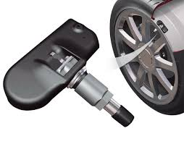
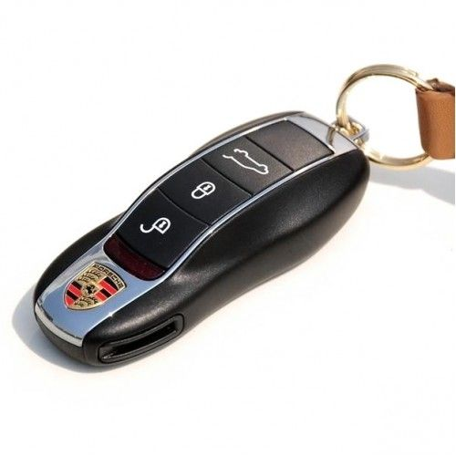
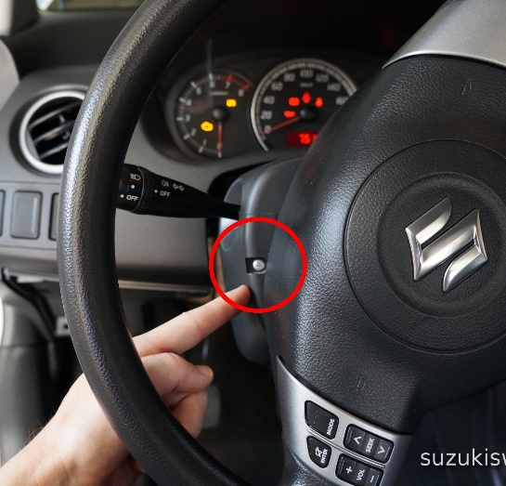
Short-range wireless
Definition: Attacks via short-range wireless communication (meters range or less)
Bluetooth
TPMS
Remote key
Immobilizer
Notes:
Next consider short range remote access
There are several approaches using short distances such as wifi, remote keyless entry, tire pressure monitoring system, bluetooth
Bluetooth has become the de facto standard for supporting hands-free calling in automobiles and is standard in vehicles sold by all major automobile manufacturers.
The Tire Pressure Monitoring System is an electronic device that senses the tire air pressure. It gives the user attention when there is a risk of accident due to low tire pressure.

Slide 12
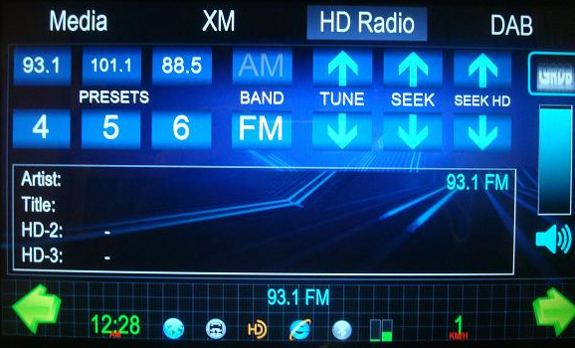
Long-range wireless
Definition: Attacks via long-rage wireless communication (miles, global-scale)
Broadcast channel
  Satellite Radio, GPS, RDS
Satellite Radio
Notes:
Finally let’s consider long range remote access
automobiles include long digital channels as well.
They devided this way into two categories: broadcast channels and addressable channels.
Broadcast channels are channels that are not speciﬁcally directed towards a target.
broadcast channels can be appealing as control channels because they can command multiple receivers at once, and do not require attackers to obtain addressing for their victims.

Slide 13
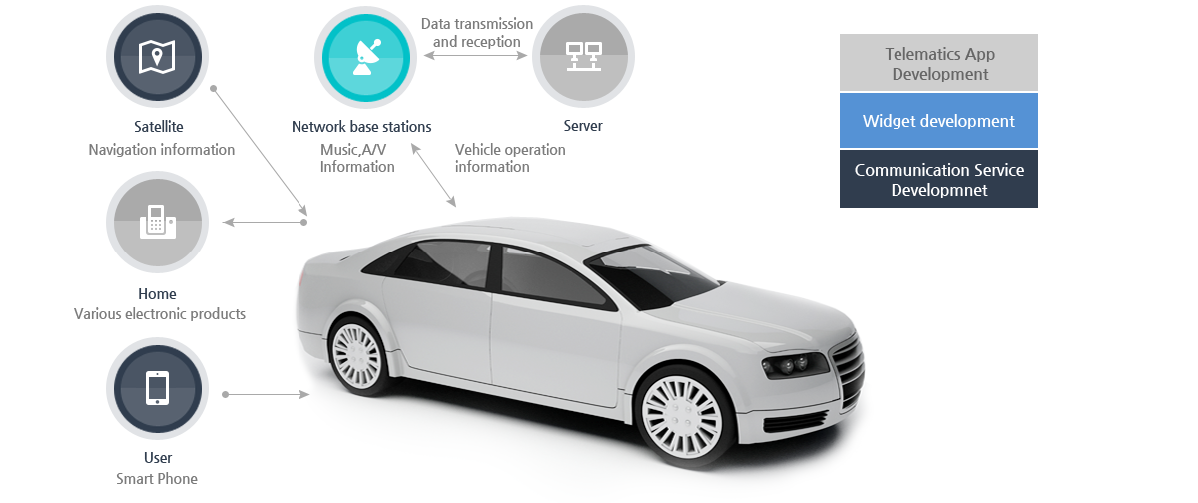
Long-range wireless
Definition: Attacks via long-rage wireless communication (miles, global-scale)
Addressable channel
  Telematics
Notes:
In contrast Broadcast channels, Addressable channels are channels that connect to a specific target,
the Remote Telematics system sends and receives a lot of information to a targets via cellular network.

Slide 14
Attack surfaces explored in depth
Components we compromised
  Indirect physical: Media player, OBDII
  Short-range wireless: Bluetooth
  Long-rage wireless: Cellular
Every attack vector leads to complete car compromise
Notes:
Among many attack vectors, they choose the following targets: Media player, OBD2, Bluetooth, Cellular
They said “Every attack vector leads to complete car compromise”

Slide 15
Premise
No direct physical access
Already know how to deal with CAN signal
Recent made sedan, 2 same model
Notes:
They defined the following premises(premis) before starting experiment.
They excluded direct attacks from attack vectors.
Because physical access is unrealistic and already done in other research.
And Attackers already know how to deal with CAN signal.
So they can make and send CAN packets to targets via CAN bus.
Finally, they attack a latest model sedan.

Slide 16
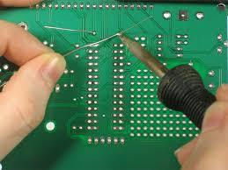
Overall methodology
Extract device’s firmware
  Read memory out over the CAN bus (CarShark)
  Desolder flash memory chips in ECUs
Reverse engineering firmware
  IDA Pro
  Custom tools
Identify and test vulnerable code paths
Notes:
They follow 3 steps to analyze vulnerabilities.
First, They extract firmware via CAN BUS or by desoldering flash memory chips of ecu.
then, Why do they extract firmware?
Because firmware has many data and programs used in ecu.
So , they reverse engineering firmware with Some tool like IDA PRO and Identify and test vulnerable code paths.

Slide 17
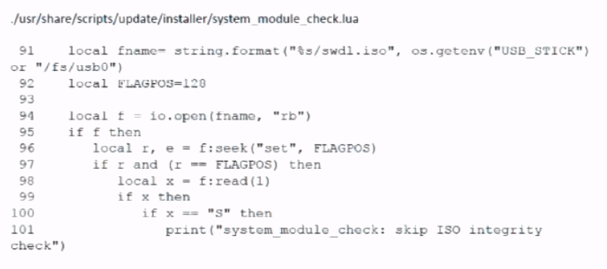
Indirect physical: Media player attack
Code for ISO-9660 leads to
  Vulnerable : in a module that uploads firmware.
Insert CD containing malicious WMA file
Completely compromise car
Notes:
So, First target is media player.
the vulnerability of media player is in a module that uploads firmware.
To upload new firmware, it looked for a binary file ending with the ASCII character S
There are No checksum ,No protections.
Just check “S”
So if we look at the binary file of media player firmware, does it have an “S” at the end?

Slide 18
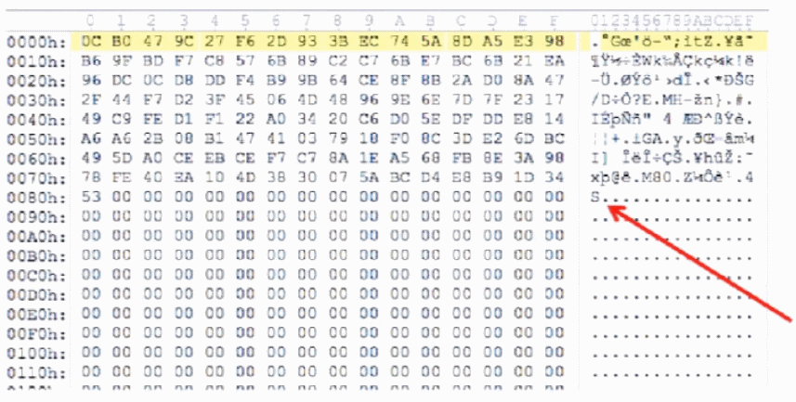
Indirect physical: Media player attack
Code for ISO-9660 leads to
  Vulnerable : in a module that uploads firmware
Notes:
Yup, there it is!
if you look at the picture, you can see that the end is “s”.
So you can bypass and install your malicious firmware in media player easily.

Slide 19
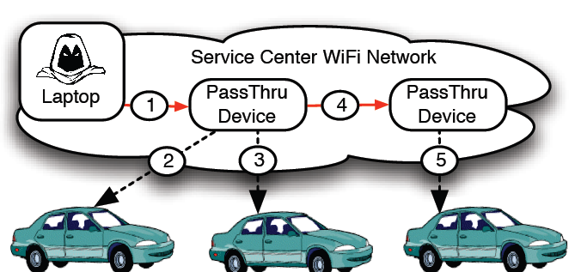
Short-range wireless: OBDII
PassThru device has no authentication method
Connect to same WiFi with device to get to CAN bus
Implant malicious code inside the device
- input validation bug
→ attacker runs arbitrary command via shell injection
- using worm fully automated spread is possible
Notes:
Next target is obd2 port.
The picture is scenario/
First, a adversary access to the service center network. (For example, while their cars are being repaired, you can access the network by asking Wi-Fi password.)
And then, the adversary can install a Trojan horse or a virus in PassTru device via wifi.
When a car is connected to malicious PassThru device like In second or third step, the malicious software will attack the cars.
The malicious program of PassThru device also (4) can be spreads to other PassThru devices and can repeat the same process (5).

Slide 20
Short-range wireless: Bluetooth attack
Custom-built code contains vulnerability
  Strcpy() bug → execute arbitrary code(Bufferoverflow)
Using owner’s smartphone as stepping-stone
  Trojan Horse application
  Check whether other party is telematics unit
  → if so it sends our attack payload
Can directly pair with Bluetooth undetectably
  USRP software radio
  MAC address ; 2ways to get
  Brute force PIN ;10hrs per car
Notes:
Bluetooth has two bug.
They found a lot of unsafe string copy functions being used in bluetooth module.
So , they analyzed this vulnerability and they found that they could run arbitrary code.
Also, if we know the MAC address of a Bluetooth module, we can connect to the bluetooth module by identifying a PIN number as brute force.

Slide 21
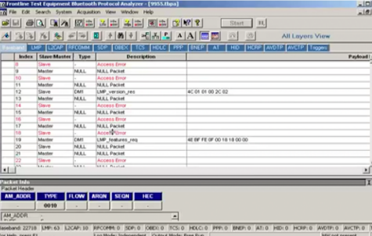
Short-range wireless: Bluetooth attack
Notes:
This video is not related to cars, but Bluetooth hacking.
So this movie shows that we can identify a PIN number as brute force
First, they find a mac address of a target.
And, they start bruteforcing a pin number with a tool.
Then, they can get a pin number of the target!
Even in this video, it took less than a minute.
Youtube:https://www.youtube.com/watch?v=EtiMQIehlfs&t=50s

Slide 22
Long-range wireless: Cellular attack
aqLink
Modem
Command
Program
1. Attack @ Lowest level of protocol stack
overflow
Use 1024bytes
packet size
Maximum 100bytes packet
Notes:
The last target is “Cellular”network.
AqLink modem is used to switch between analog and digital bits.
aqLink supports packet sizes up to 1024 bytes.
However a command program assumes that packets will never exceed 100bytes.
So if we send packets over 100 bytes, an overflow occurs in command programs.
Then, what can we do for hacking a car?

Slide 23

Car theft
1. Compromise car
2. Get Car’s INFO (GPS…)
3. Unlock doors
4. Start engine
5. Bypass anti-theft
Notes:
We can consider the following scenarios
If you want a car, first compromise the car and get the car's information.
And when no one is there, go to the car, unlock the door, start the engine and run away.
Then the car will be yours!
However, since this scenario can easily be caught, so I encourage next scenarios

Slide 24
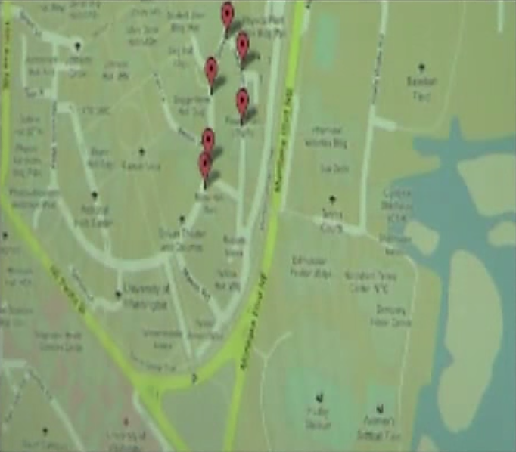
Surveillance
Compromised car
Continuously report GPS coordinates
Stream audio recorded from the in-cabin mic
  Detect voice (VAD)
  Compress audio
  Stream to remote computer
  E.g.) Professor Yongdae Kim
Notes:
Car hacking can be used for surveillance as well
if you want to monitor someone, Continuously report GPS coordinates and stream audio from the in-cabin mic.
This scenario will be very difficult to catch by others.

Slide 25
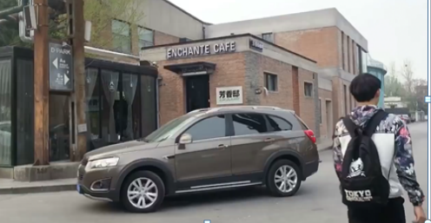
Where to go from here?
Notes:
[https://www.youtube.com/watch?v=bXfp8F4J2eI] 동영상 추가
Based on today research, Q 360 team showed that they approach a victim and spoof the key signal.
Then they can hijack victim’s car.
To spoofing key signal, they just use 11$ radio gadget.

Slide 26

Where to go from here?
`13
`11
Today’s paper
“Dude, WTF in my car?”
by Alberto and Dude
`15
`14
“Jeep Cherokee hacking“
by Charlie Miller
and Chris Valasek
“A Survey of Remote Automotive Attack Surfaces”
by Charlie Miller and Chris Valasek
`16
`18
“Remote Attack Tesla“
by Keen Lab
“14 vulnerabilities in BMW”
by Chinese security team
Notes:
And, a lot of hacking accidents is here.
Beginning with today paper.
Alberto and Dude presented in black hat about that by flooding the ECU with data, they could disable the ECU.
In 2014, Charlie miller and 크리스 발라섹 surveyed of remote automotive attack surfaces of each car.
And based on it, they hacked a Jeep Cherokee by exploiting vulnerabilities of “unconnect system” using cellular network.
Keen lab also hacked Tesla in 2016. They identified a bug of web browser, so they used them.
Recently, Chinese security team found 14 vulnerabilities of BMW.

Slide 27
Where to go from here?
Stakeholders responding today:
  SAE, USCAR, US DOT
Recommendation : lessons from the PC world
  Avoid unsafe function
  Remove unnecessary binaries e.g.) ftp/telnet/vi
  ASLR (Address Space Layout Randomization)
  Stack cookies
  Limited inbound calls
Notes:
Based on the various attack vectors and vulnerabilities, they give a few security advice.
They said
don’t use unsafe function like strcpy Remove other unnecessary software.
Use stack cookies and ASLR to protect stack value.. And..so on.
Automakers need to put a lot of effort to make our car secure.

Slide 28
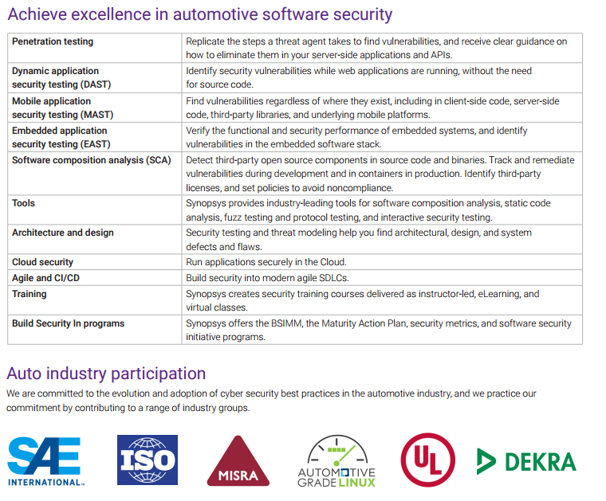
Where to go from here?
Future work
  Developing new protocol alternative to CAN bus
  Research how to encrypt CAN message
  CAN monitoring system to catch external attack
Notes:
So, many automotive industry companies are carrying out the following tests for car security.
Penetration testing, dynamic application security testing and embeded application security test are involved in the list.

Slide 29
Where to go from here?
Future work
  Developing new protocol alternative to CAN bus
  Research how to encrypt CAN message
  CAN monitoring system to catch external attack
Notes:
So, Future researches have following ideas:
I think it is important that developing new protocol alternative to CAN bus, because currently CAN bus is unsecure.
Or, if use the CAN bus constantly, we have to research how to encrypt CAN message.
Also we need CAN monitoring system to catch external attack.

Slide 30



Summary
Current autos have broad (and increasing) external attack surface
They demonstrated real attacks that compromised safety-critical systems
Industry and government are responsible
Notes:
In today paper, they found various possible attack vectors for vehicles and indeed these attack vectors were valid.
The attack vectors have three approaches.
they also points out problems with vehicle security , gives practical advice, and warns about future vehicle vulnerabilities.

Slide 31

Notes:
That is all
Do you have any question?

